Slide 1


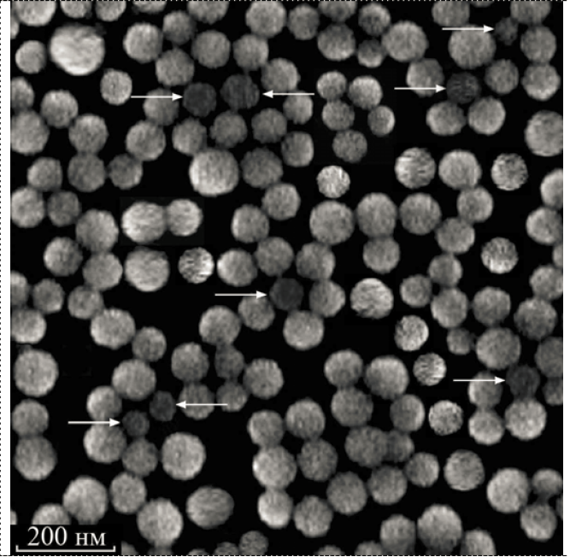
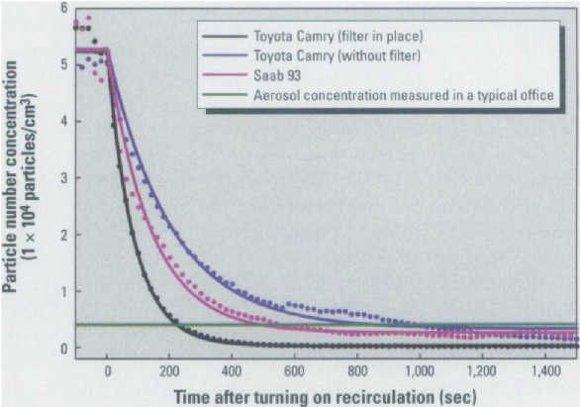
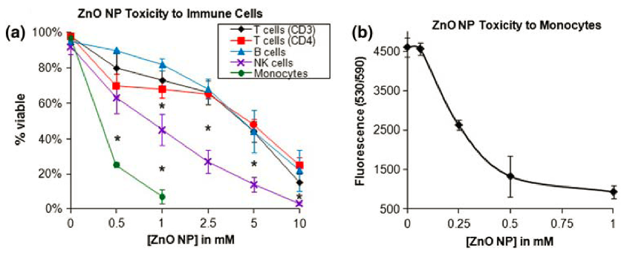
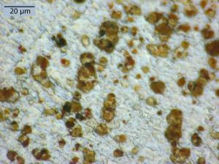

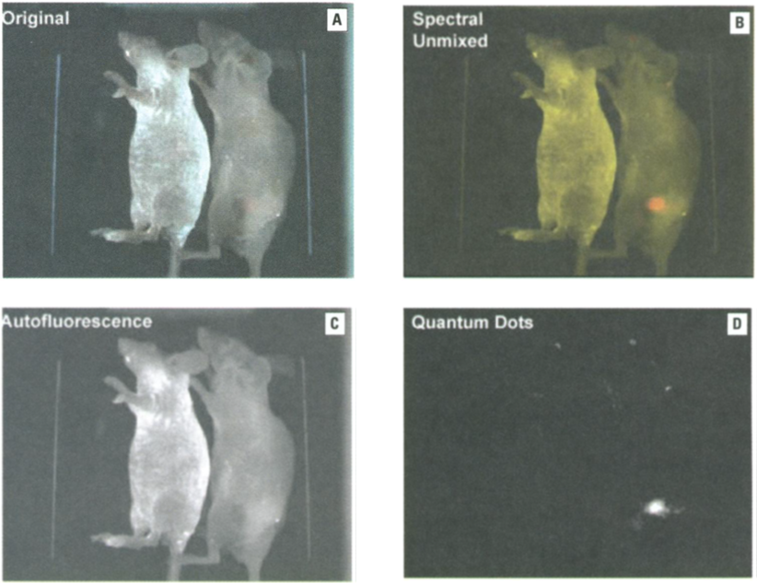
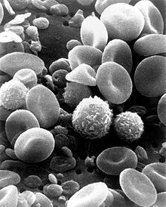
Nanoparticle Production and Application Concerns
Yifan Ge
Department of Electrical Engineering, Bucknell University, Lewisburg, PA
Abstract
Concerns about Nanoparticles
Possible Solutions
The discovery and development of nanotechnology have been one of the most promising innovations. However, the development of nanotechnology was slowed down by some safety problems lately. This research covers the current problems discovered by scientific groups and some possible solutions for preventing human beings being disposed to nanoparticles.
With so many applications, humans are likely to be exposed to nanoparticles. This exposure not only comes from related occupation, but also from direct medicinal applications. Thus, the safety of using nanoparticles becomes essential. At the same time, however, our understanding of the potential toxicity of nanoparticles remains rudimentary. The following two research results suggest that nanoparticles could cause negative effects on humans’ health.
One research as been done by a group of scientists on the influences of Cell Type and ZnO Nanoparticle on Immune Cell Cytotoxicity. The results from these studies demonstrate that ZnO Nanoparticles has some cytotoxic effects on human immune cells. As shown in the figures below. ZnO has the most effect on Monocytes.
Sk. Maksimov pointed out that to ensure safety in mass production of nanoparticles we must have means of revealing of fractions of particles with peculiar structural-morphological characteristics. One possible way of improving the nanoparticle mass production process is using means of advanced scanning electron microscopy. The Figure 5 is a SEM image.
Background
In the study of nanotechnology, there are two type of particles. One is called “ultrafine particles”, which are traditionally used to describe airborne particles with diameters < 100nm. The other one is called “nanoparticles”, which are defined as engineered structures with diameters < 100nm. The figures below shows the two types of particles.
Figure 5. SEM images of SiO_{x} particles.
Figure 6. Measured in-cabin particle number concentration with time for a Toyota Camry and a Saab 93 while driving in heavy traffic.
University of Minnesota, University of Rochester, and Woodrow Wilson Center for Scholars have done another investigation on the effectiveness of recirculating air filtration on reducing exposure to airborne nanoparticles under different scenarios. The promising result indicates that advanced filtration technology could lead to significant reductions in airborne nanoparticle exposure. Figure 6 shows the concentration of airborne nanoparticles with and without filtration.
Figure 1. Ultrafine particles from fine dust emission.¹
Figure 2. White light nanoparticles developed by researchers from University of Utah²
Figure 4. Differential cytotoxic effects of ZnO NPs on human immune cell subsets.
Benefits from Nanoparticles
More Concerns
Conclusion
As the particles get to the size of nanometer scale, the surface to volume ratio becomes significantly large. These particles start to have properties depending on their sizes and become extremely active with the environment.
One of the major fields is health care. Nanoparticles improve the diagnosis and detection of many diseases. The following images shows the significant advantage of using Quantum Dots in cancer targeting.
Another research has been done by E. Silbergeld of Johns Hopkins University emphasizing on the both positive and negative interactions that take place in the normal functioning immune systems. She pointed out that since the immune system functions through nanoscale intercellular communications, engineered nanoparticles are liked to be able to disrupt these processes with deleterious end results.
Zhao et al. has also studied negative effect of Nanoparticles. He predicted that DNA repair, another vital biological system that operates at the nanoscale, is also susceptible to be modified by nanoparticles.
Utilizing nanotechnology has been proved to be extremely beneficial in areas such medication. However, commercial development of nanotechnology and its many applications may result negative effect on human beings. Thus, we need to obtain a more throughout understanding of the negative effects of nanoparticles on human health and develop safer ways to mass produce and apply nanotechnology.
Figure 3. A) Image of control animals, with no fluorescence; B) Xenograft tumor-bearing animal showing bright red fluorescence of tumor; C) Autofluorescent superimposed image of control and tumor-bearing animals. D) Autofluorescent unmixed quantum dot image.
References
http://www.sciencedaily.com/releases/2009/10/091005094919.htm
http://nanogloss.com/category/nanoparticles/#axzz1dGtdOkDO
J. M. Balbus, A. D. Maynard, V. L. Colvin, V. Castranova, G. P. Daston, R. A. Denison, K. L. Dreher, P. L. Goering, A. M. Goldberg, K. M. Kulinowski, N. A. Monteiro-Riviere, G. Oberdörster, G. S. Omenn, K. E. Pinkerton, K. S. Ramos, K. M. Rest, J. B. Sass, E. K. Silbergeld and B. A. Wong, "Meeting Report: Hazard Assessment for Nanoparticles: Report from an Interdisciplinary Workshop," Environ. Health Perspect., vol. 115, pp. pp. 1654-1659, Nov., 2007.
M. R. Gwinn and V. Vallyathan, "Nanoparticles: Health Effects: Pros and Cons," Environ. Health Perspect., vol. 114, pp. pp. 1818-1825, Dec., 2006.
S. K. Maksimov and K. S. Maksimov, "Problem of safety in nanoparticle mass production and its solution by means of advanced scanning electron microscopy," in 3rd International Forum on Nanotechnology, Rusnanotech 2010, November 1, 2010 - November 3, 2011, .
D. Y. H. Pui, C. Qi, N. Stanley, G. Oberdörster and A. Maynard, "Recirculating Air Filtration Significantly Reduces Exposure to Airborne Nanoparticles," Environ. Health Perspect., vol. 116, pp. pp. 863-866, Jul., 2008.
Figure 5. A scanning electron microscope image of normal circulating human blood.

